Slide 2
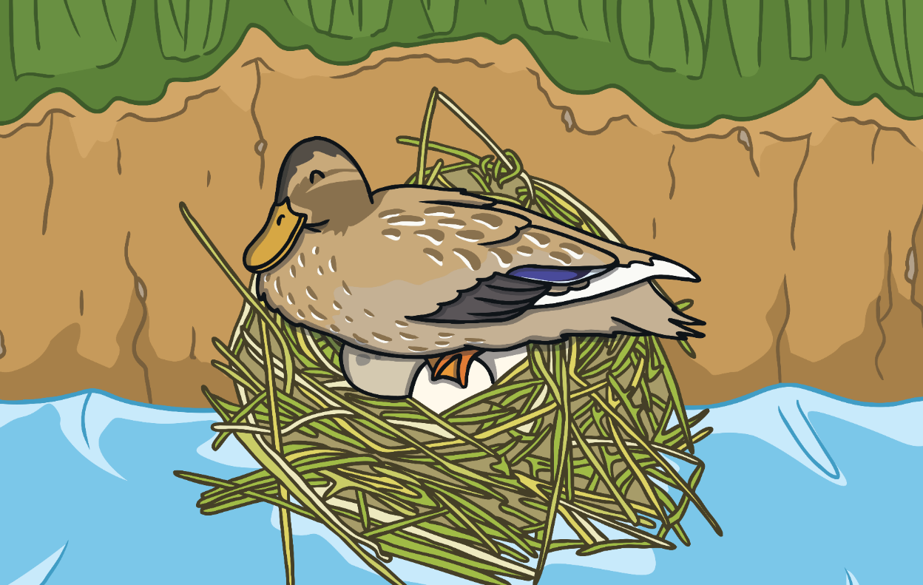
Once upon a time a mother duck was waiting for her eggs to hatch.

Slide 3
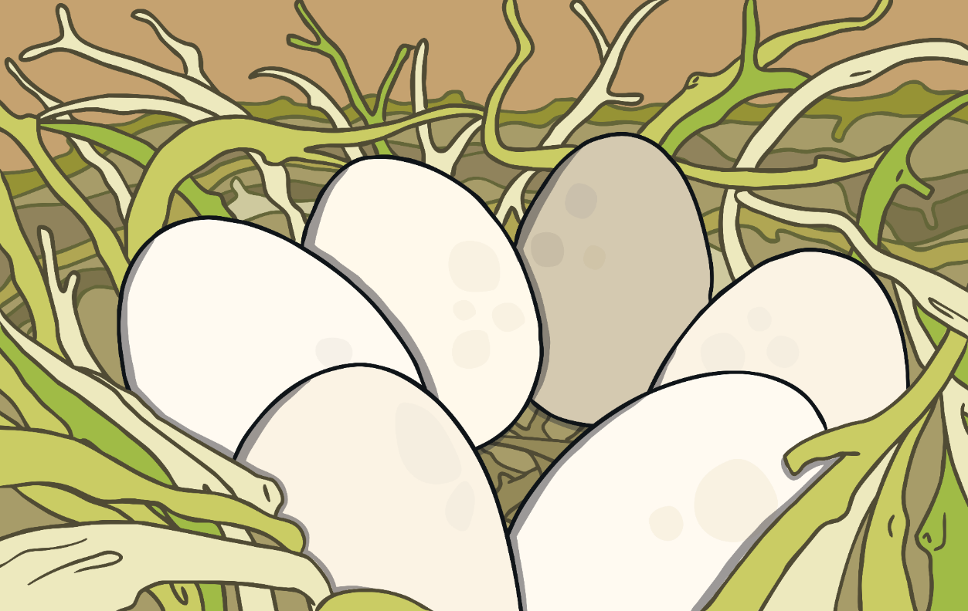
The eggs were white, all except one.

Slide 4
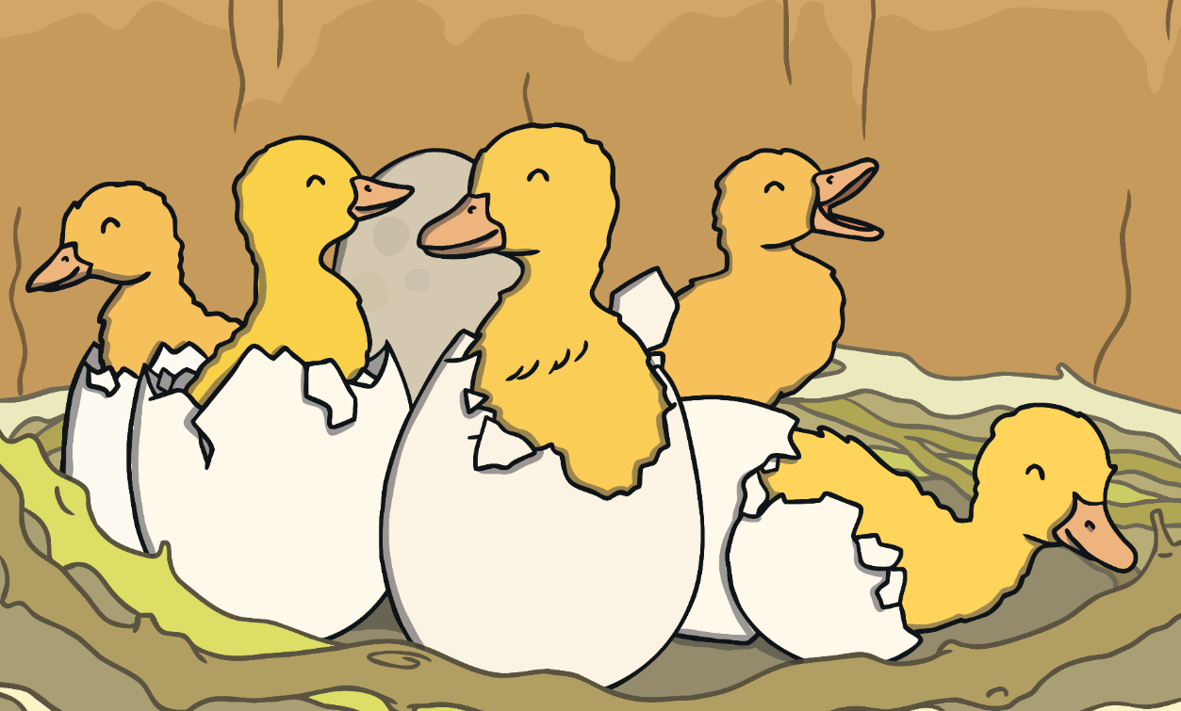
Soon the eggs began to hatch, and the duck became a proud mother of 5 little ducklings.

Slide 5
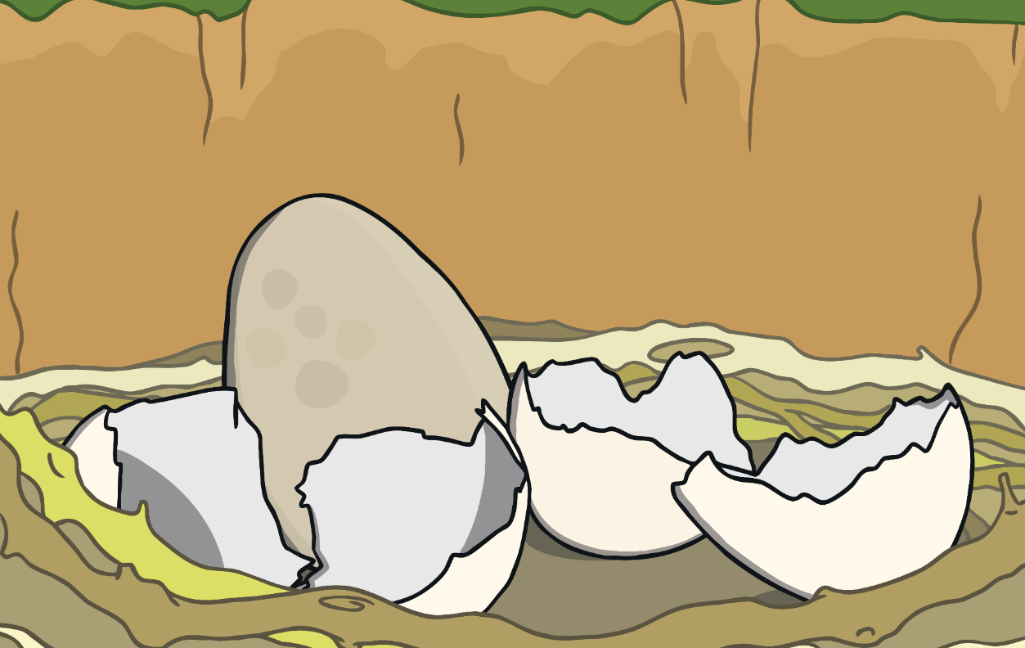
But one egg remained...

Slide 6
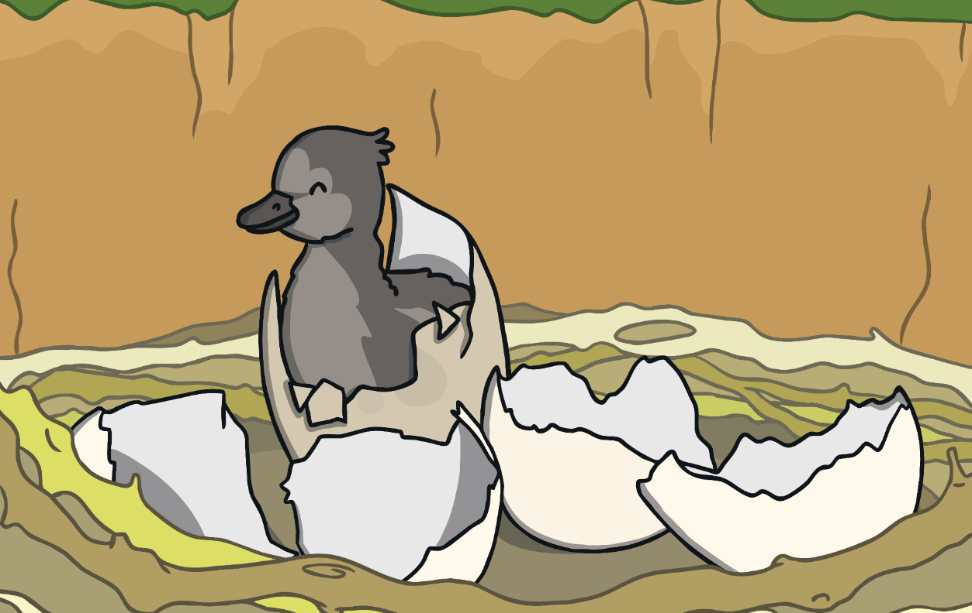
Finally the last duckling hatched.

Slide 7
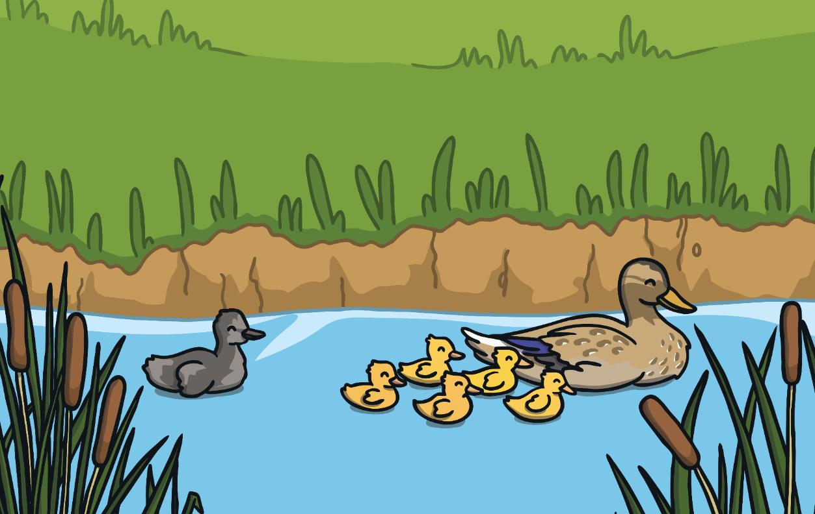
But he was different from the other ducklings.

Slide 8
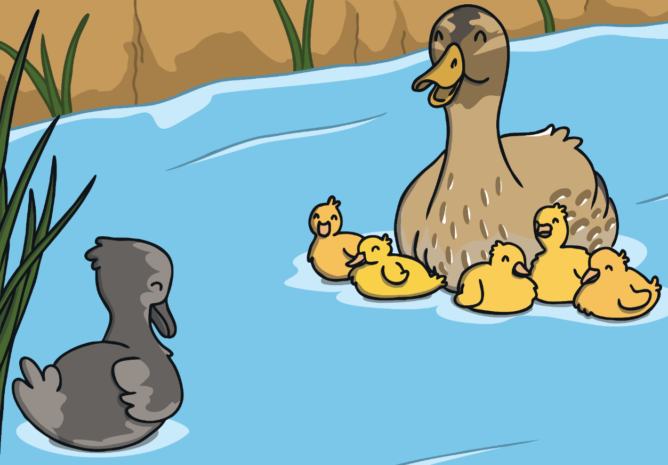
Why are you different?

Slide 9
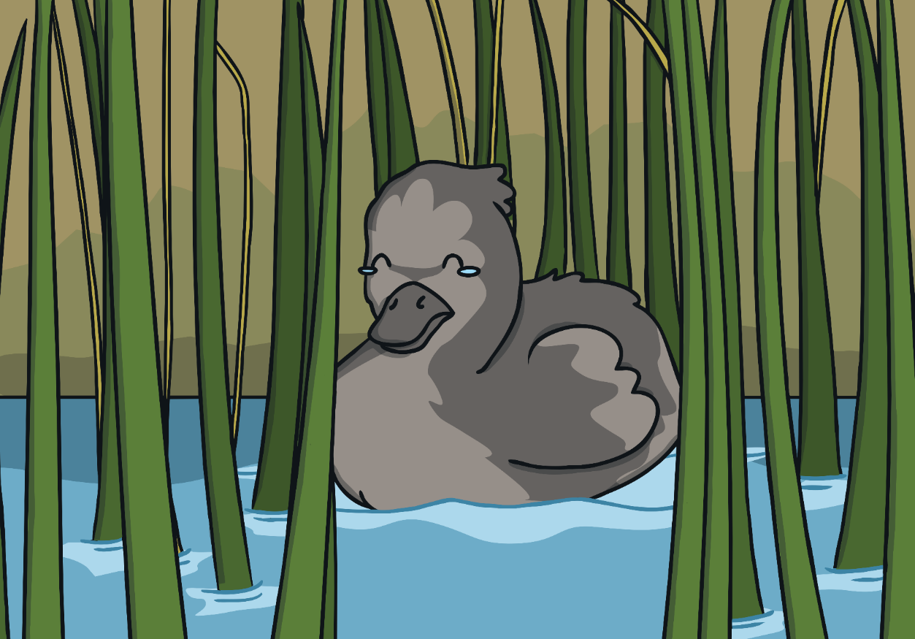
Nobody loves me because I am different.

Slide 10
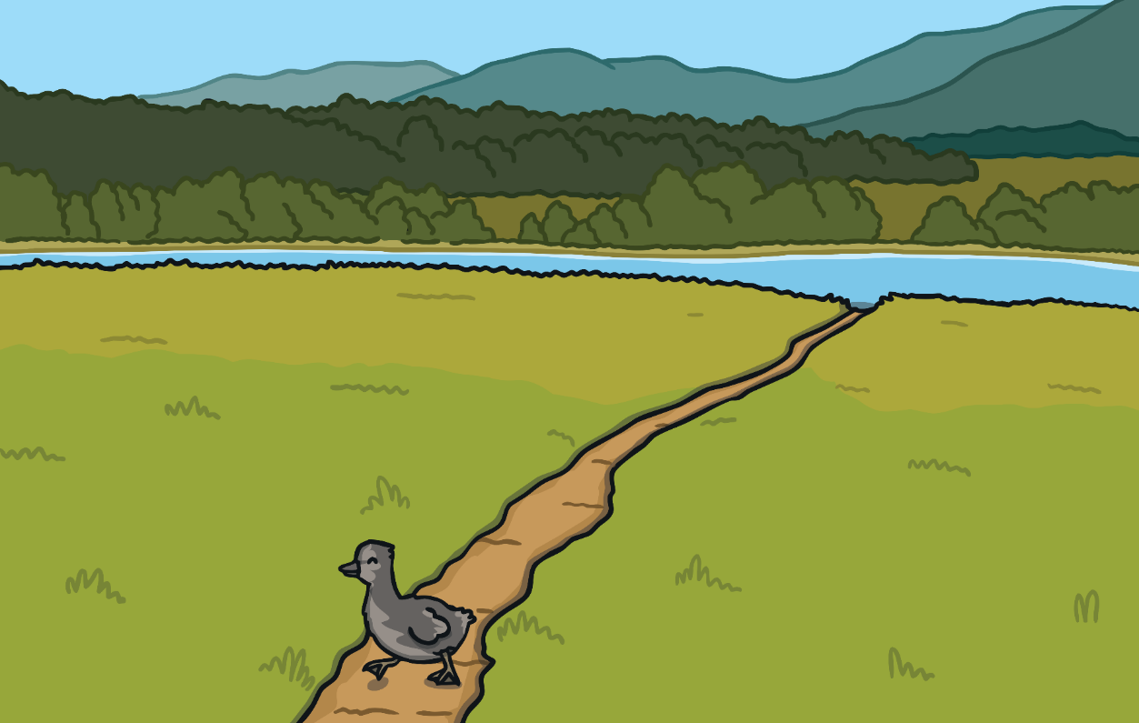
The ugly duckling left home to look for a place he belonged.

Slide 11
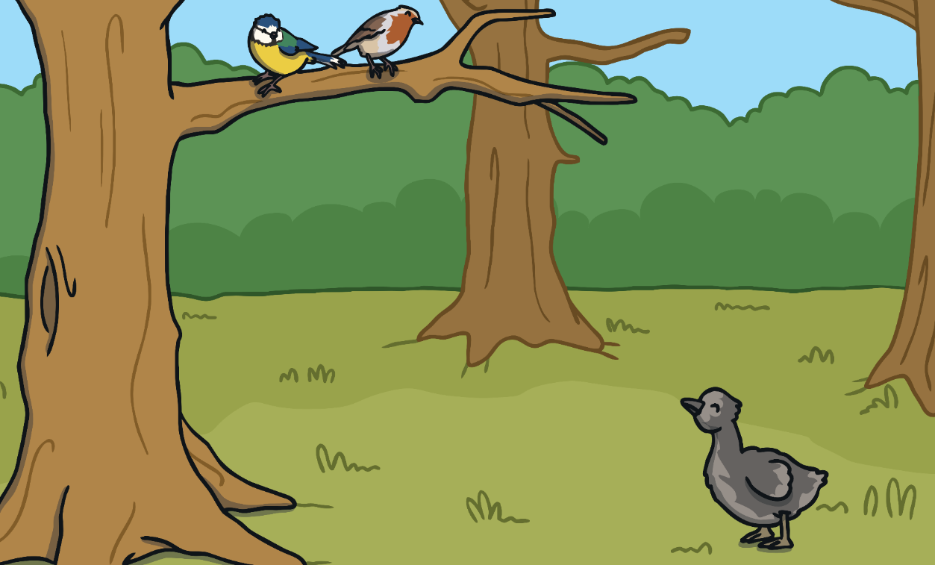
He came across some other birds, but they did not want to be friends with such an odd-looking duckling.

Slide 12
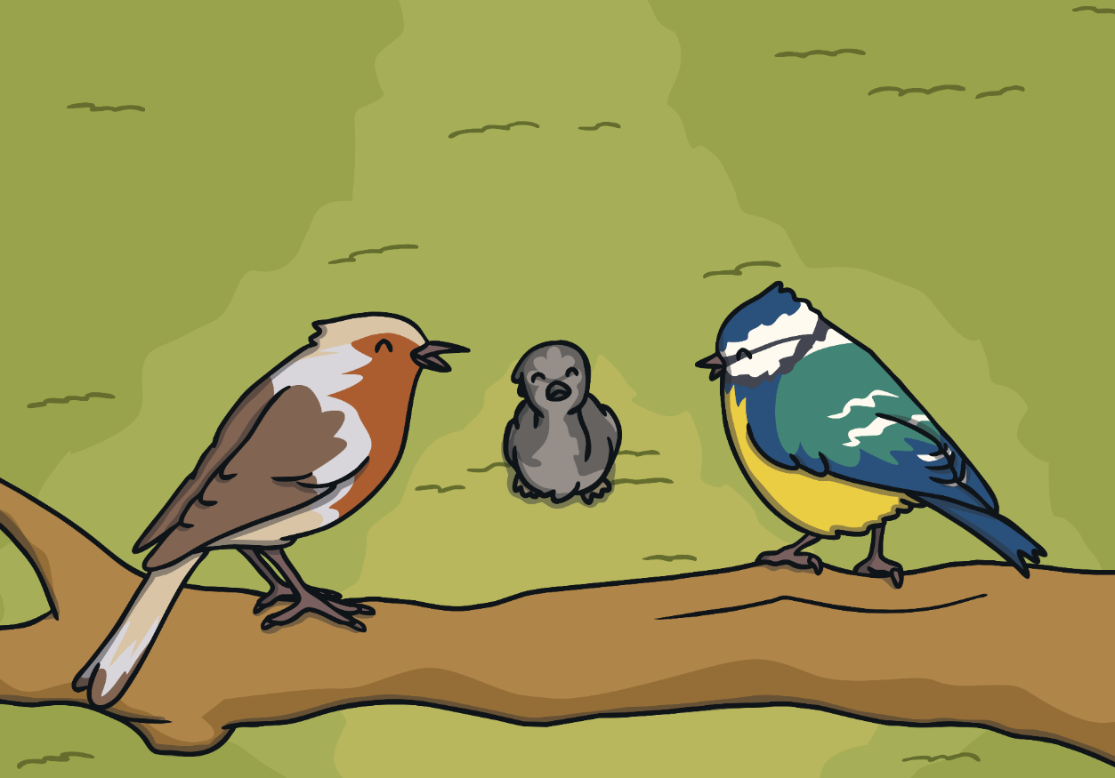
You look strange.
You’re ugly.

Slide 13
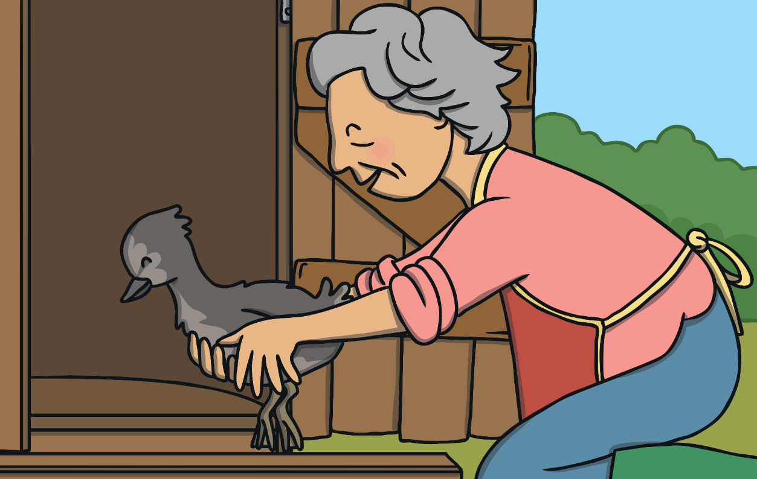
An old woman found the duckling and put him in her hutch.

Slide 14
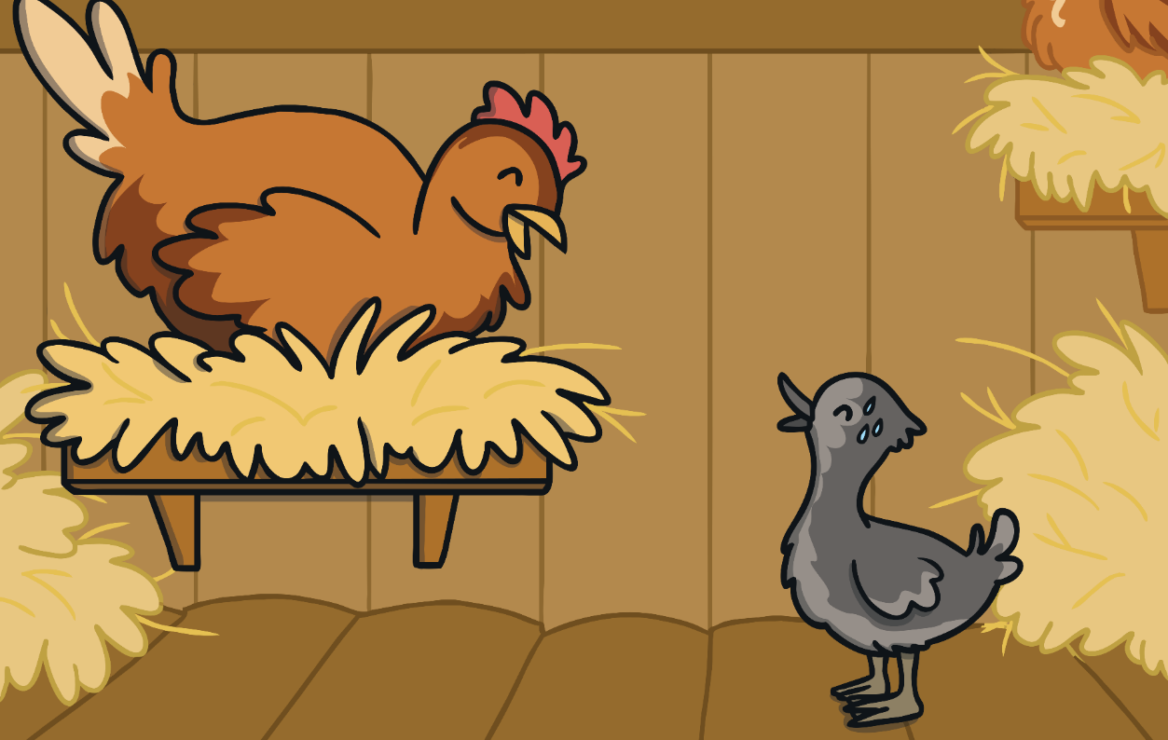
The woman’s hen warned the duckling that she planned to eat him.

Slide 15
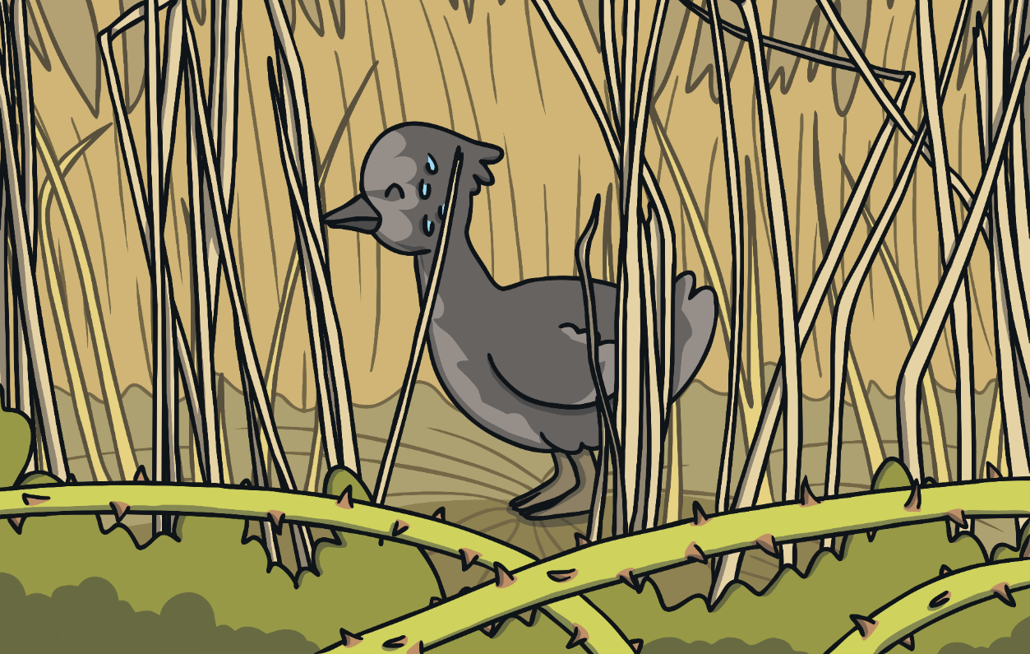
The poor duckling escaped and hid in some reeds.

Slide 16
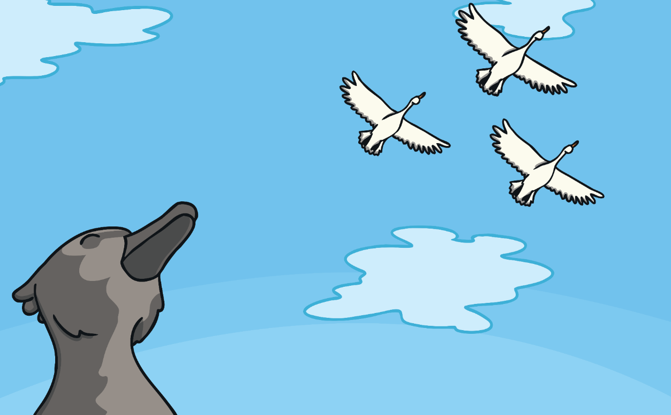
He saw some beautiful birds fly above him, and he wished that he was like them.

Slide 17
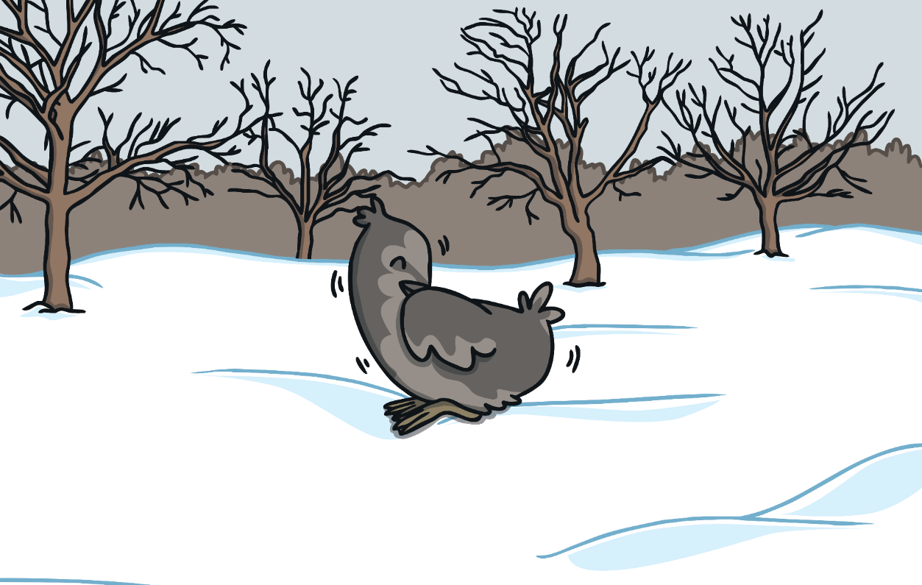
Winter came and the little duckling was cold.

Slide 18
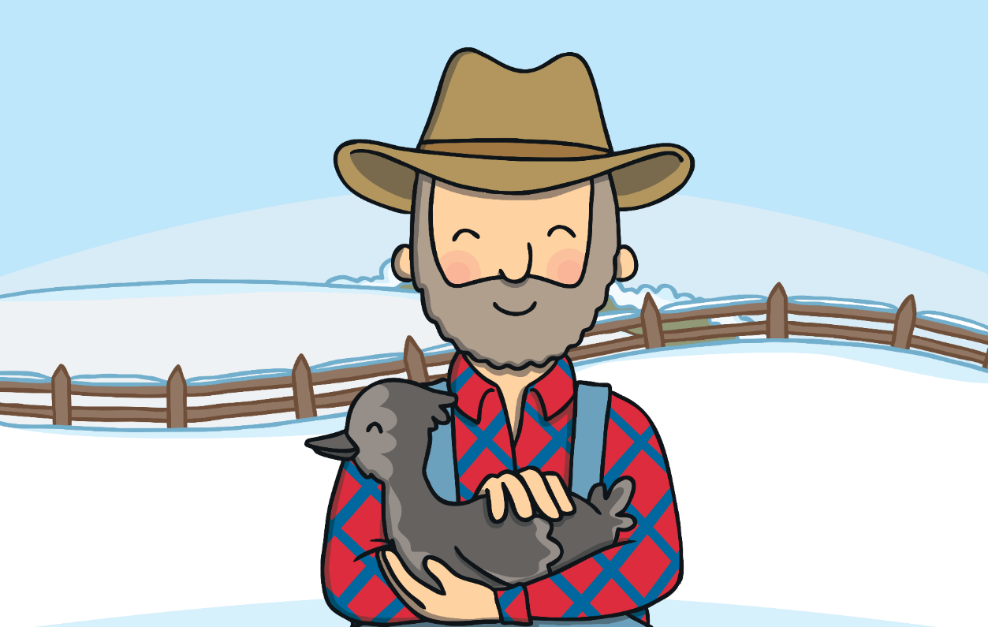
But a farmer found him and kept him safe until the spring.

Slide 19
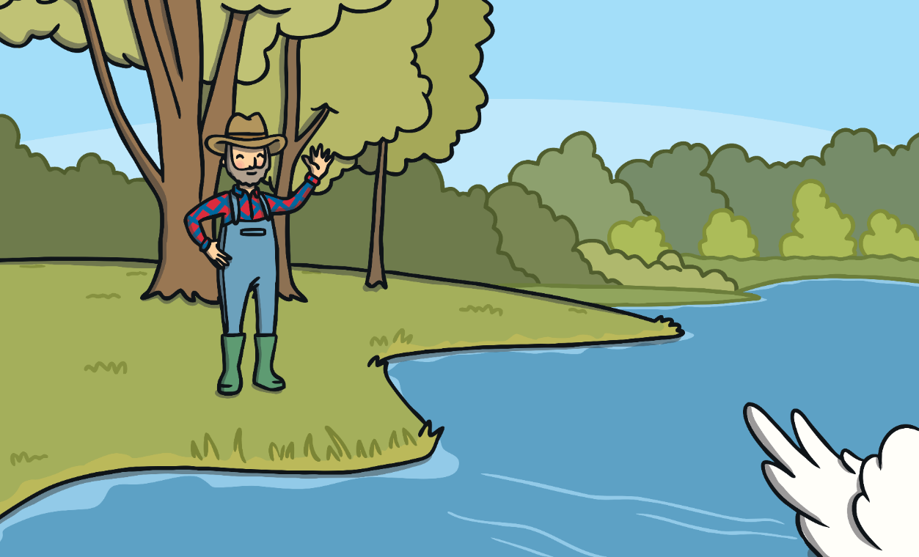
When spring came, the farmer took the duckling to the pond and released him. Something wonderful had happened…

Slide 20
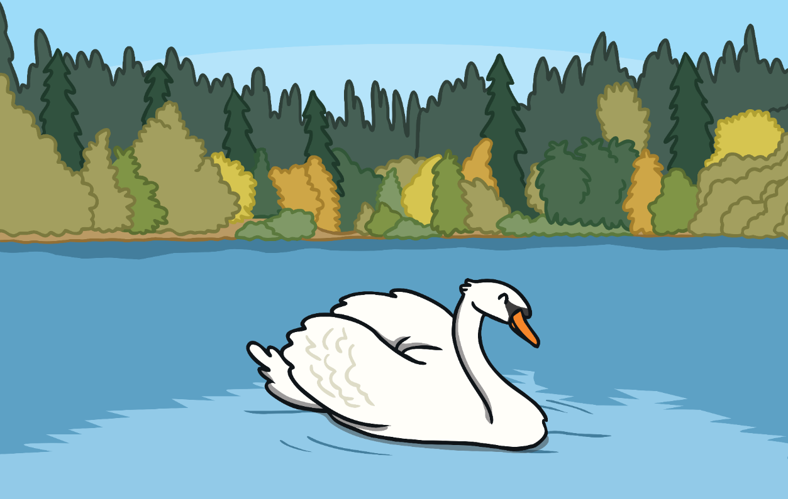
…the duckling had grown into a beautiful swan!

Slide 21
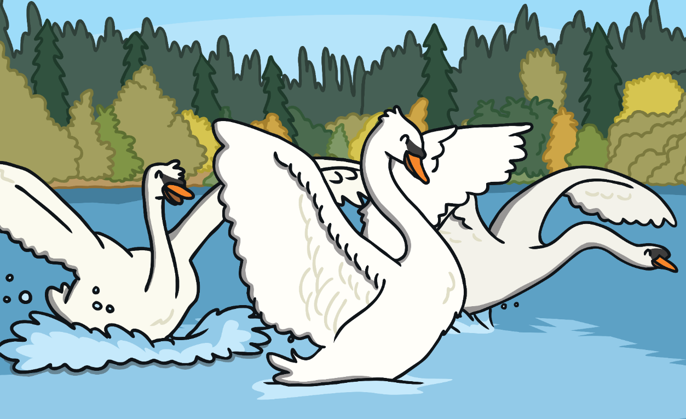
He soon made lots of new friends and was the most beautiful swan of them all!

